Slide 1
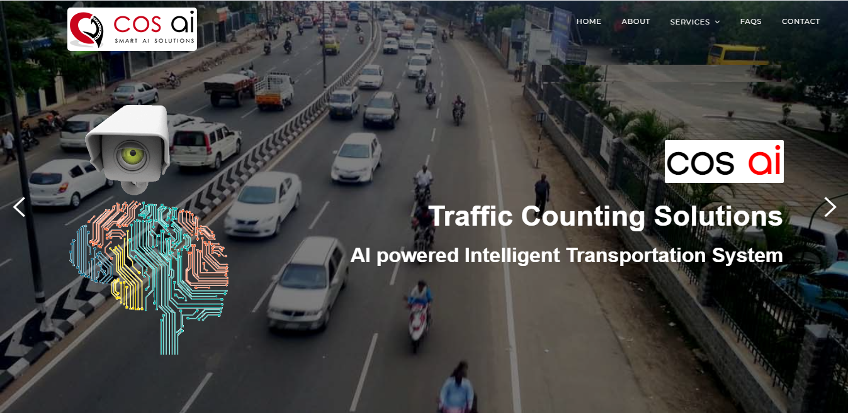
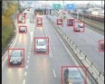
ATCC LOGIN

Slide 2

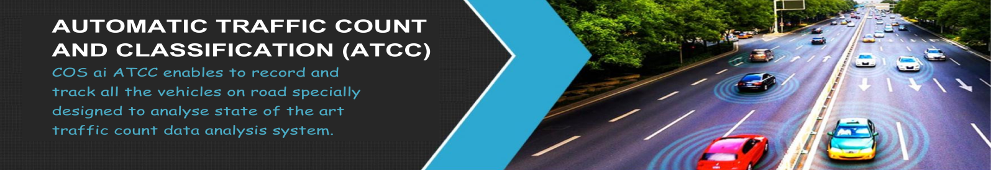


AUTOMATIC TRAFFIC COUNT AND CLASSIFICATION (ATCC)
Home
WELCOME TO ATCC
Please Log on to Proceed
User Email ID:
Password:
smile
(Case Sensitive) Load New Code
(Please Enter The Security Code
shown in the Text Box Provided.)
Forgot password?
LOGIN
Don’t have account ?
Register Now
USER
OFFICE USER
LOGIN

Slide 3


AUTOMATIC TRAFFIC COUNT AND CLASSIFICATION (ATCC)
Home
Please Log on to Proceed
User Email ID:
User Email ID or Mobile No:
Password:
(OTP will be sent to your E-mail / mobile)
smile
Enter Your OTP: *
(Case Sensitive) Load New Code
(Please Enter The Security Code
shown in the Text Box Provided.)
Forgot password?
LOGIN
2
Create your New Password: *
Don’t have account ?
Register Now
Re-enter your New Password: *
USER
OFFICE USER
LOGIN

Slide 4

AUTOMATIC TRAFFIC COUNT AND CLASSIFICATION (ATCC)
Home
USER REGISTRATION
First Name: *
Last Name: *
Name of the company: *
Designation: *
Select
Type of Business: *
Address:
E-Mail ID: *
Mobile Number: *
Create your Password: *
(OTP will be sent to your mobile)
Consultant / Firm
Concessionaire / Contractor
Government Officials
Others
Enter Your OTP: *
You have successfully Registered

Slide 5
AUTOMATIC TRAFFIC COUNT AND CLASSIFICATION (ATCC)
Home
OFFICE USER REGISTRATION
First Name: *
Last Name: *
Name of the company: *
Select
Designation: *
E-Mail ID: *
Mobile Number: *
Create your Password: *
(OTP will be sent to your mobile)
Managing Director
Python Developer
Data Analysist
IOT
---------
Enter Your OTP: *
You have successfully Registered

Slide 6





AUTOMATIC TRAFFIC COUNT AND CLASSIFICATION (ATCC)
Home
DISPLAY THE USER NAME
Uploading Video
Name of the project: *
Name of the Consultant: *
Name of the Department: *
Video: *
20 fps
23.97 fps
24 fps
25 fps
----------
1280 x 720
1920 x 1080
2560 x 1440
3840 x 2160
----------
Select
Select
fps:
Resolution:
From : (dd/mm/yyyy)
To : (dd/mm/yyyy)
Date of Capturing :*
Towards --------------------
Location:*
UP:
(Hr/Min/Sec)
(Hr/Min/Sec)
Towards --------------------
Start Time:*
End Time:*
Down:
(Hr/Min/Sec)
(Hr/Min/Sec)
------------
--------
Start Time:*
End Time:*
Up & Down:
To
Upload Video:*

Slide 7



AUTOMATIC TRAFFIC COUNT AND CALSSIFICATION (ATCC)
Home
Client: NHAI | Project: 4/6 Laning of NH 844 | Location: Neraluru – Dharmapuri | Date: 29.04.2021 | Time: 8.00 AM – 9.00 PM
SI.No | Date | Time | Car | MotorCycle | Auto_Rickshaw | Tanker_Lorry | LCV | Truck_TAV | Truck_MAV | Earth_vehicle | Bus | Van | Tracktor | Tracktor_trailer
1 | 13-04-2021 | 06:14:59 | 12 | 4 | 0 | 3 | 1 | 16 | 13 | 0 | 1 | 0 | 0 | 0
2 | 13-04-2021 | 06:29:59 | 31 | 29 | 0 | 5 | 6 | 38 | 35 | 0 | 7 | 0 | 0 | 0
3 | 13-04-2021 | 06:44:59 | 46 | 61 | 1 | 8 | 10 | 71 | 66 | 1 | 8 | 0 | 0 | 0
4 | 13-04-2021 | 06:59:59 | 73 | 94 | 1 | 8 | 18 | 89 | 81 | 1 | 12 | 0 | 0 | 0
5 | 13-04-2021 | 07:14:59 | 93 | 124 | 1 | 11 | 23 | 101 | 98 | 1 | 12 | 0 | 0 | 0
6 | 13-04-2021 | 07:29:59 | 132 | 160 | 2 | 17 | 26 | 121 | 122 | 1 | 15 | 1 | 0 | 0
7 | 13-04-2021 | 07:44:59 | 168 | 184 | 3 | 20 | 29 | 144 | 138 | 1 | 18 | 1 | 0 | 0
8 | 13-04-2021 | 07:59:59 | 214 | 207 | 3 | 24 | 35 | 164 | 160 | 1 | 19 | 2 | 0 | 0
9 | 13-04-2021 | 08:14:59 | 254 | 230 | 5 | 25 | 40 | 180 | 181 | 1 | 22 | 2 | 0 | 0
10 | 13-04-2021 | 08:29:59 | 308 | 272 | 6 | 27 | 47 | 188 | 194 | 2 | 30 | 2 | 0 | 0
11 | 13-04-2021 | 08:44:59 | 354 | 306 | 6 | 28 | 51 | 207 | 220 | 4 | 34 | 2 | 0 | 0
12 | 13-04-2021 | 08:59:59 | 409 | 344 | 7 | 30 | 54 | 228 | 241 | 5 | 37 | 3 | 0 | 0
13 | 13-04-2021 | 09:14:59 | 462 | 396 | 8 | 33 | 60 | 245 | 262 | 5 | 42 | 5 | 0 | 1
14 | 13-04-2021 | 09:29:59 | 510 | 432 | 8 | 33 | 71 | 257 | 284 | 5 | 49 | 5 | 0 | 1
15 | 13-04-2021 | 09:44:59 | 563 | 465 | 10 | 38 | 82 | 268 | 304 | 6 | 51 | 5 | 0 | 1
16 | 13-04-2021 | 09:59:59 | 617 | 501 | 10 | 38 | 94 | 287 | 320 | 7 | 53 | 5 | 0 | 1
17 | 13-04-2021 | 10:14:59 | 680 | 541 | 11 | 40 | 105 | 306 | 336 | 7 | 56 | 5 | 0 | 1
18 | 13-04-2021 | 10:29:59 | 724 | 577 | 12 | 45 | 117 | 323 | 356 | 7 | 57 | 5 | 0 | 1
19 | 13-04-2021 | 10:44:59 | 771 | 617 | 12 | 47 | 126 | 341 | 376 | 7 | 60 | 5 | 0 | 1
20 | 13-04-2021 | 10:59:59 | 819 | 657 | 13 | 48 | 137 | 356 | 399 | 9 | 63 | 5 | 0 | 1
21 | 13-04-2021 | 11:14:59 | 877 | 700 | 13 | 49 | 142 | 367 | 418 | 9 | 67 | 5 | 0 | 1
22 | 13-04-2021 | 11:29:59 | 943 | 724 | 13 | 49 | 155 | 381 | 441 | 10 | 72 | 5 | 0 | 1
23 | 13-04-2021 | 11:44:59 | 990 | 770 | 13 | 50 | 166 | 393 | 463 | 10 | 77 | 6 | 0 | 1
24 | 13-04-2021 | 11:59:59 | 1028 | 808 | 14 | 52 | 177 | 402 | 479 | 10 | 80 | 6 | 0 | 1
Detected Image
Output Video
Unreview Transaction
Reviewed Transaction
Hourly Counting
PCU Abstract
ADT
ADT (PCU)

Slide 8




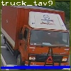
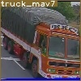


AUTOMATIC TRAFFIC COUNT AND CALSSIFICATION (ATCC)
Home
Client: NHAI | Project: 4/6 Laning of NH 844 | Location: Neraluru – Dharmapuri | Date: 29.04.2021 | Time: 8.00 AM – 9.00 PM
Detected Image
Output Video
Unreviewed Transaction
Sl.No | Date | Time | Location | Lane | Class as per ATCC | Class as per IRC | Vehicle Image | Review
1 | 15-04-2021 | 07:16:32 | Thoppur | 2 | Motor-cycle | Two wheeler
2 | 15-04-2021 | 07:16:33 | Thoppur | 2 | Motor-Cycle | Two wheeler
3 | 15-04-2021 | 07:16:39 | Thoppur | 2 | Truck-TAV | Two axle
4 | 15-04-2021 | 07:16:41 | Thoppur | 2 | Truck-MAV | Multi axle
5 | 15-04-2021 | 07:16:54 | Thoppur | 2 | Car | Car/Van/Jeep
Unreview Transaction
Reviewed Transaction
Hourly Counting
PCU Abstract
ADT
ADT (PCU)

Slide 9
AUTOMATIC TRAFFIC COUNT AND CALSSIFICATION (ATCC)
Home
Client: NHAI | Project: 4/6 Laning of NH 844 | Location: Neraluru – Dharmapuri | Date: 29.04.2021 | Time: 8.00 AM – 9.00 PM
Detected Image
Output Video
Hourly Counting
SI.No | Date | Time | Car/Van/ Jeep | Two wheeler | Auto Three wheeler | Two axle vehicle | MAV | Mini truck<3T | Bus | Agricultural Tractor | Agricultural Tracktor_trailer
1 | 13.04.2021 | 6.00AM-7.00AM | 73 | 94 | 1 | 97 | 81 | 19 | 12 | 0 | 0
2 | 13.04.2021 | 7.00AM-8.00AM | 143 | 113 | 2 | 91 | 79 | 17 | 7 | 0 | 0
3 | 13.04.2021 | 8.00AM-9.00AM | 196 | 137 | 4 | 70 | 81 | 23 | 18 | 0 | 0
4 | 13.04.2021 | 9.00AM-10.00AM | 210 | 157 | 3 | 67 | 79 | 42 | 16 | 0 | 1
5 | 13.04.2021 | 10.00AM-11.00AM | 202 | 156 | 3 | 79 | 79 | 45 | 10 | 0 | 0
6 | 13.04.2021 | 11.00AM-12.00PM | 210 | 151 | 1 | 50 | 80 | 41 | 17 | 0 | 0
7 | 13.04.2021 | 12.00PM-01.00PM | 160 | 115 | 0 | 69 | 69 | 31 | 15 | 0 | 0
8 | 13.04.2021 | 01.00PM-02.00PM | 165 | 111 | 4 | 47 | 73 | 28 | 27 | 0 | 0
9 | 13.04.2021 | 02.00PM-03.00PM | 99 | 69 | 1 | 53 | 51 | 23 | 14 | 0 | 0
10 | 13.04.2021 | 03.00PM-04.00PM | 154 | 94 | 2 | 63 | 75 | 40 | 17 | 0 | 0
11 | 13.04.2021 | 04.00PM-05.00PM | 182 | 87 | 3 | 78 | 67 | 39 | 23 | 0 | 0
12 | 13.04.2021 | 05.00PM-06.00PM | 166 | 145 | 6 | 101 | 72 | 38 | 16 | 0 | 0
Unreview Transaction
Reviewed Transaction
Hourly Counting
PCU Abstract
ADT
ADT (PCU)

Slide 10
AUTOMATIC TRAFFIC COUNT AND CALSSIFICATION (ATCC)
Home
Client: NHAI | Project: 4/6 Laning of NH 844 | Location: Neraluru – Dharmapuri | Date: 29.04.2021 | Time: 8.00 AM – 9.00 PM
PCU Abstract
SI.No | Date | Time | Car/Van/ Jeep | Two wheeler | Auto Three wheeler | Two axle vehicle | MAV | Mini truck<3T | Bus | Agricultural Tractor | Agricultural Tracktor_trailer
1 | 13.04.2021 | 06.00AM-07.00AM | 199 | 182 | 4 | 236 | 111 | 50 | 29 | 0 | 0
2 | 13.04.2021 | 07.00AM-08.00AM | 308 | 237 | 3 | 260 | 113 | 60 | 18 | 0 | 0
3 | 13.04.2021 | 08.00AM-09.00AM | 388 | 312 | 11 | 221 | 115 | 64 | 35 | 0 | 0
4 | 13.04.2021 | 09.00AM-10.00AM | 457 | 347 | 3 | 202 | 118 | 78 | 31 | 0 | 1
5 | 13.04.2021 | 10.00AM-11.00AM | 450 | 380 | 6 | 215 | 125 | 88 | 21 | 0 | 0
6 | 13.04.2021 | 11.00AM-12.00PM | 495 | 326 | 4 | 209 | 123 | 67 | 31 | 0 | 0
7 | 13.04.2021 | 12.00PM-01.00PM | 432 | 256 | 4 | 241 | 128 | 68 | 39 | 1 | 0
8 | 13.04.2021 | 01.00PM-02.00PM | 418 | 252 | 7 | 187 | 143 | 52 | 47 | 0 | 0
9 | 13.04.2021 | 02.00PM-03.00PM | 362 | 202 | 2 | 202 | 118 | 55 | 31 | 0 | 0
10 | 13.04.2021 | 03.00PM-04.00PM | 451 | 231 | 10 | 212 | 153 | 68 | 38 | 0 | 0
11 | 13.04.2021 | 04.00PM-05.00PM | 494 | 263 | 8 | 254 | 143 | 62 | 43 | 0 | 0
12 | 13.04.2021 | 05.00PM-06.00PM | 500 | 333 | 7 | 270 | 170 | 65 | 36 | 0 | 0
13 | 13.04.2021 | 06.00PM-07.00PM | 424 | 239 | 6 | 175 | 141 | 80 | 29 | 1 | 1
14 | 13.04.2021 | 07.00PM-08.00PM | 385 | 192 | 6 | 212 | 175 | 100 | 34 | 0 | 0
15 | 13.04.2021 | 08.00PM-09.00PM | 347 | 145 | 5 | 248 | 209 | 120 | 40 | 0 | 0
16 | 13.04.2021 | 09.00PM-10.00PM | 266 | 77 | 6 | 252 | 245 | 108 | 38 | 0 | 0
17 | 13.04.2021 | 10.00PM-11.00PM | 231 | 64 | 5 | 286 | 240 | 112 | 39 | 0 | 0
18 | 13.04.2021 | 11.00PM-12.00AM | 203 | 64 | 0 | 214 | 195 | 66 | 23 | 0 | 0
19 | 13.04.2021 | 12.00AM-01.00AM | 119 | 22 | 0 | 213 | 243 | 55 | 30 | 1 | 0
20 | 14.04.2021 | 01.00AM-02.00AM | 81 | 9 | 0 | 177 | 119 | 26 | 18 | 0 | 0
21 | 14.04.2021 | 02.00AM-03.00AM | 68 | 6 | 0 | 177 | 116 | 23 | 26 | 0 | 0
22 | 14.04.2021 | 03.00AM-04.00AM | 62 | 10 | 0 | 226 | 160 | 20 | 31 | 0 | 0
23 | 14.04.2021 | 04.00AM-05.00AM | 64 | 25 | 0 | 228 | 102 | 14 | 18 | 0 | 0
24 | 14.04.2021 | 05.00AM-06.00AM | 115 | 69 | 0 | 246 | 98 | 25 | 28 | 0 | 0
 | TOTAL |  | 7319 | 4243 | 97 | 5363 | 3603 | 1525 | 753 | 3 | 2
 | PCU Factor |  | 1 | 0.5 | 1 | 3 | 4.5 | 1.5 | 3 | 1.5 | 4.5
 | PCU |  | 7319 | 2122 | 97 | 16088 | 16214 | 2288 | 2258 | 4 | 8
Detected Image
Output Video
Unreview Transaction
Reviewed Transaction
Hourly Counting
PCU Abstract
ADT
ADT (PCU)

Slide 11
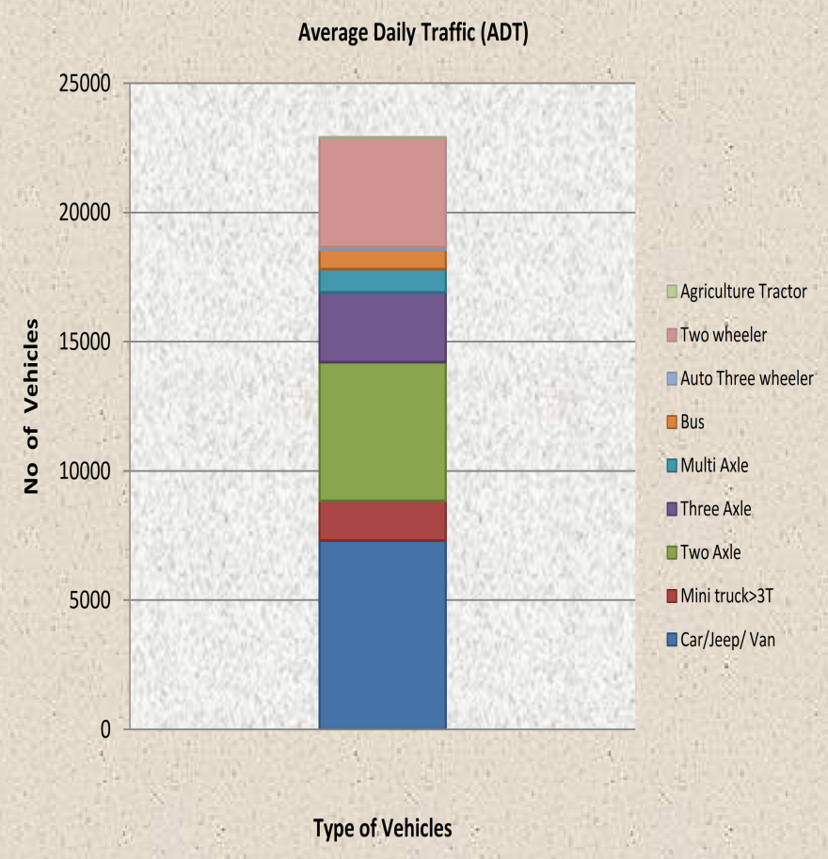
AUTOMATIC TRAFFIC COUNT AND CALSSIFICATION (ATCC)
Home
Client: NHAI | Project: 4/6 Laning of NH 844 | Location: Neraluru – Dharmapuri | Date: 29.04.2021 | Time: 8.00 AM – 9.00 PM
Detected Image
Output Video
Average Daily Traffic (ADT)
ADT ( in Vehicles / day )
Type of Vehicles | No of Vehicles
Car/Jeep/ Van | 7319
Mini truck>3T | 1525
Two Axle | 5363
Three Axle | 2702
Multi Axle | 901
Bus | 753
Auto Three wheeler | 97
Two wheeler | 4243
Agriculture Tractor | 5
TOTAL | 22906
Unreview Transaction
Reviewed Transaction
Hourly Counting
PCU Abstract
ADT
ADT (PCU)

Slide 12
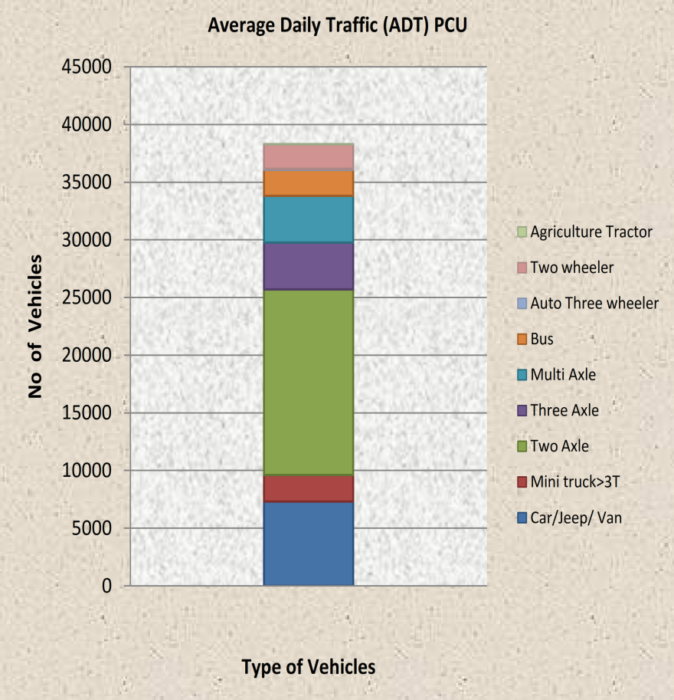
AUTOMATIC TRAFFIC COUNT AND CALSSIFICATION (ATCC)
Home
Client: NHAI | Project: 4/6 Laning of NH 844 | Location: Neraluru – Dharmapuri | Date: 29.04.2021 | Time: 8.00 AM – 9.00 PM
Detected Image
Output Video
Average Daily Traffic (ADT) PCU
ADT ( in PCU / day )
Type of Vehicles | No of Vehicles
Car/Jeep/ Van | 7319
Mini truck>3T | 2288
Two Axle | 16088
Three Axle | 12160
Multi Axle | 4053
Bus | 2258
Auto Three wheeler | 97
Two wheeler | 2122
Agriculture Tractor | 12
TOTAL | 46396
Unreview Transaction
Reviewed Transaction
Hourly Counting
PCU Abstract
ADT
ADT (PCU)

Slide 13
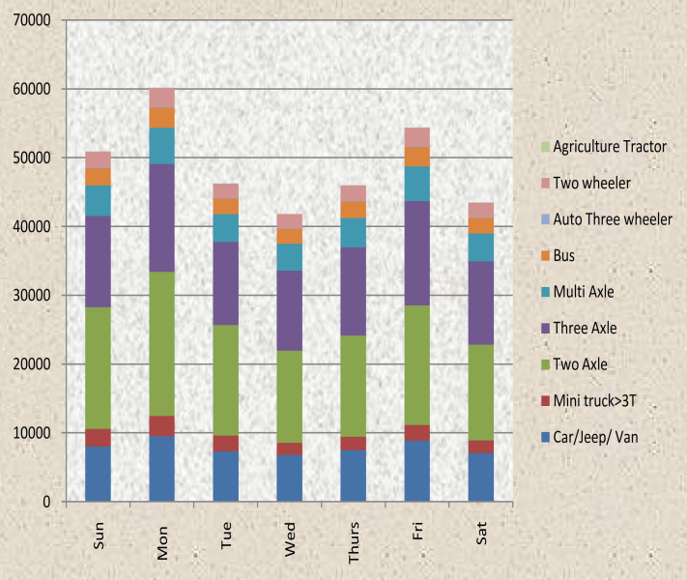
AUTOMATIC TRAFFIC COUNT AND CALSSIFICATION (ATCC)
Home
Client: NHAI | Project: 4/6 Laning of NH 844 | Location: Neraluru – Dharmapuri | Date: 29.04.2021 | Time: 8.00 AM – 9.00 PM
Detected Image
Output Video
Daily Traffic Variation (PCU)
TYPE OF VEHICLES | Sun | Mon | Tue | Wed | Thurs | Fri | Sat
 | 11.04.21 | 12-04-21 | 13-04-21 | 14-04-21 | 15-04-21 | 16-04-21 | 17-04-21
Car/Jeep/ Van | 8051 | 9514 | 7319 | 6812 | 7493 | 8855 | 7084
Mini truck>3T | 2517 | 2974 | 2288 | 1767 | 1944 | 2298 | 1838
Two Axle | 17696 | 20914 | 16088 | 13361 | 14697 | 17370 | 13896
Three Axle | 13272 | 15685 | 12066 | 11671 | 12838 | 15172 | 12138
Multi Axle | 4459 | 5269 | 4053 | 3890 | 4279 | 5057 | 4046
Bus | 2484 | 2936 | 2258 | 2182 | 2400 | 2836 | 2269
Auto Three wheeler | 106 | 125 | 97 | 87 | 96 | 113 | 90
Two wheeler | 2334 | 2758 | 2122 | 2065 | 2272 | 2685 | 2148
Agriculture Tractor | 13 | 16 | 12 | 5 | 5 | 6 | 5
TOTAL | 50932 | 60192 | 46301 | 41841 | 46025 | 54393 | 43514
Unreview Transaction
Daily Traffic Variation (PCU)
Reviewed Transaction
Hourly Counting
PCU Abstract
Days
ADT
Daily Traffic Variation(PCU)

Slide 14
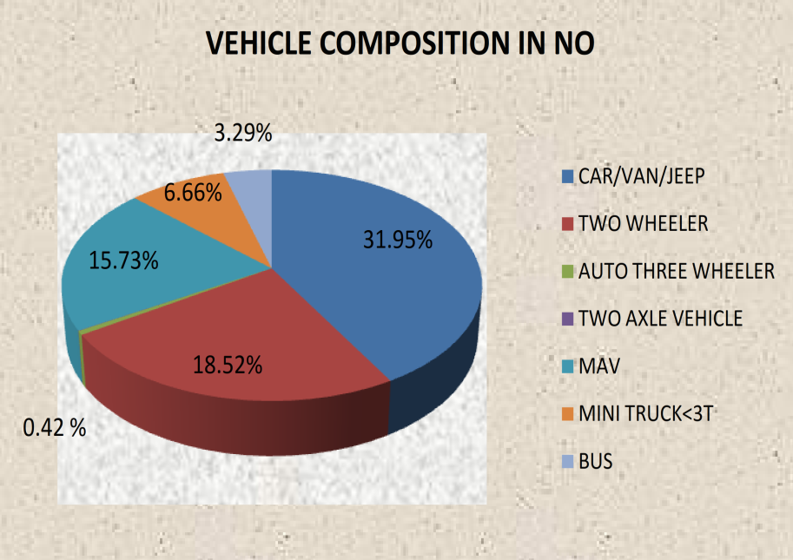
AUTOMATIC TRAFFIC COUNT AND CALSSIFICATION (ATCC)
Home
Client: NHAI | Project: 4/6 Laning of NH 844 | Location: Neraluru – Dharmapuri | Date: 29.04.2021 | Time: 8.00 AM – 9.00 PM
Detected Image
Output Video
Vehicle Composition in Number
VEHICLE COMPOSITION IN NUMBER
NAME OF VEHICLES | VEHICLE COMPOSITION IN NO
Car/Van/Jeep | 31.95
Two Wheeler | 18.52
Auto Three Wheeler | 0.42
Two Axle Vehicle | 0.03
MAV | 15.73
Mini Truck<3t | 6.66
Bus | 3.29
Agricultural Tractor | 0.01
Agricultural Tractor Trailer | 0.01
Unreview Transaction
Reviewed Transaction
Hourly Counting
PCU Abstract
ADT
Vehicle Comp. in No

Slide 15
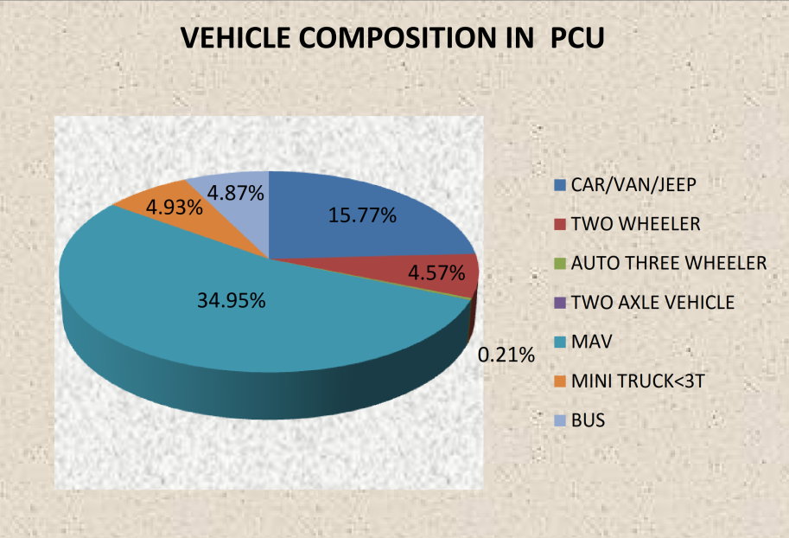
AUTOMATIC TRAFFIC COUNT AND CALSSIFICATION (ATCC)
Home
Client: NHAI | Project: 4/6 Laning of NH 844 | Location: Neraluru – Dharmapuri | Date: 29.04.2021 | Time: 8.00 AM – 9.00 PM
Detected Image
Output Video
Vehicle Composition in PCU
VEHICLE COMPOSITION IN PCU
NAME OF VEHICLES | VEHICLE COMPOSITION IN PCU
Car/Van/Jeep | 15.77
Two Wheeler | 4.57
Auto Three Wheeler | 0.21
Two Axle Vehicle | 0.02
MAV | 34.95
Mini Truck<3t | 4.93
Bus | 4.87
Agricultural Tractor | 0.01
Agricultural Tractor Trailer | 0.02
Unreview Transaction
Reviewed Transaction
Hourly Counting
PCU Abstract
ADT
Vehicle Comp. in PCU

Slide 16
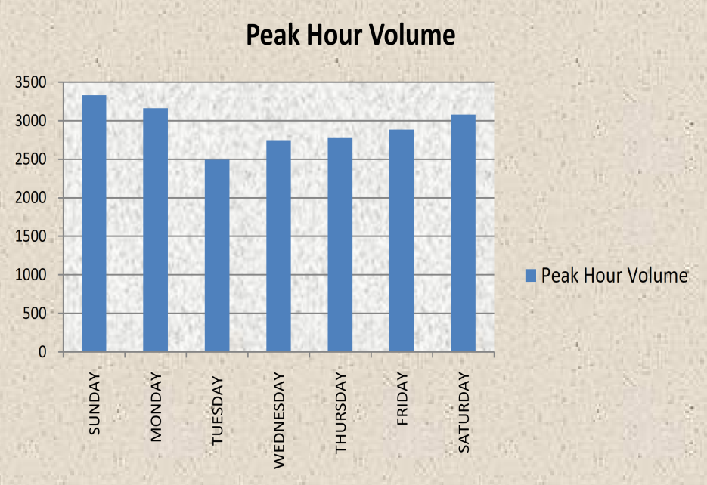
AUTOMATIC TRAFFIC COUNT AND CALSSIFICATION (ATCC)
Home
Client: NHAI | Project: 4/6 Laning of NH 844 | Location: Neraluru – Dharmapuri | Date: 29.04.2021 | Time: 8.00 AM – 9.00 PM
Peak Hour Traffic
PEAK HOUR TRAFFFIC
Days | Date | Peak Hour | Peak Hour Volume
Sunday | 11.04.2021 | 10.00PM-11.00PM | 3329
Monday | 12.04.2021 | 06.00PM-07.00PM | 3158
Tuesday | 13.04.2021 | 10.00PM-11.00PM | 2491
Wednesday | 14.04.2021 | 07.00PM-08.00PM | 2747
Thursday | 15.04.2021 | 06.00PM-07.00PM | 2774
Friday | 16.04.2021 | 07.00PM-08.00PM | 2884
Saturday | 17.04.2021 | 08.00PM-09.00PM | 3079
 |  | APCU | 20462
Detected Image
Output Video
Unreview Transaction
Reviewed Transaction
Hourly Counting
PCU Abstract
ADT
Days
Peak Hour Volume

